Slide 1
Circuit Demo V and I Curves
Kenny Hora

Slide 2
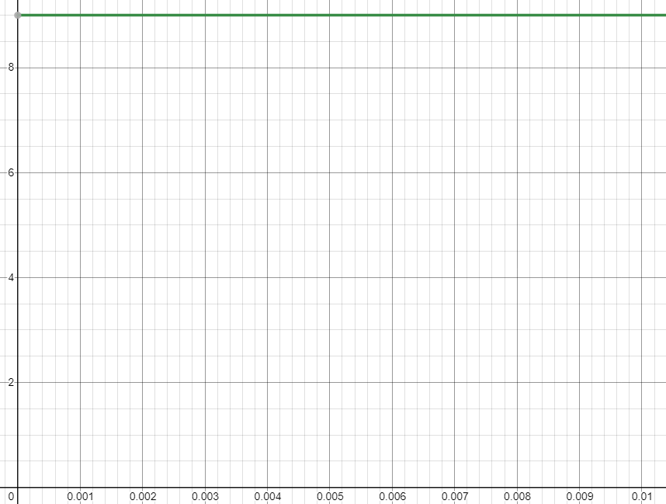
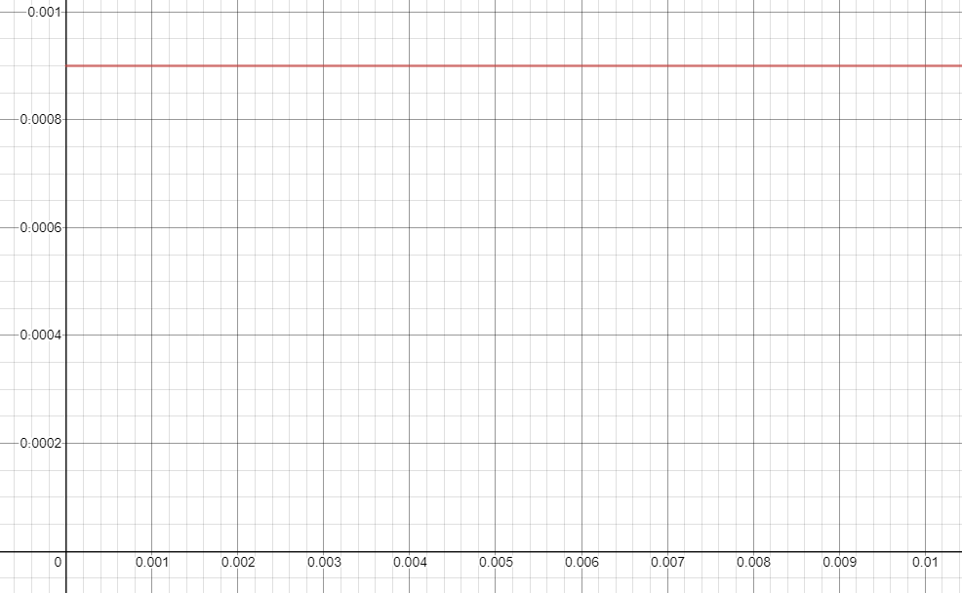
Resistor
Voltage (V on y-axis and sec. on x-axis)
Current (A on y-axis and sec. on x-axis)

Slide 3
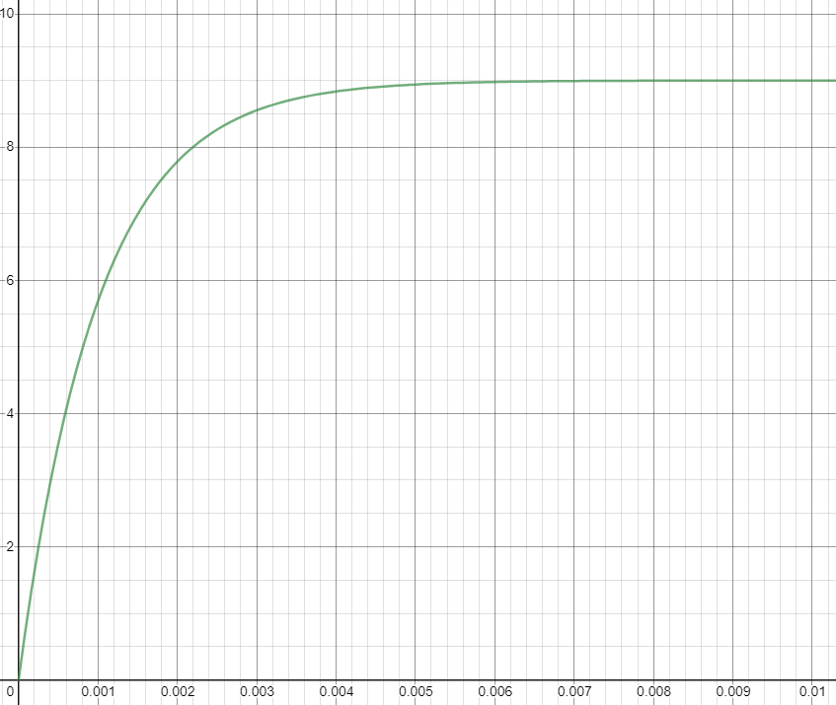
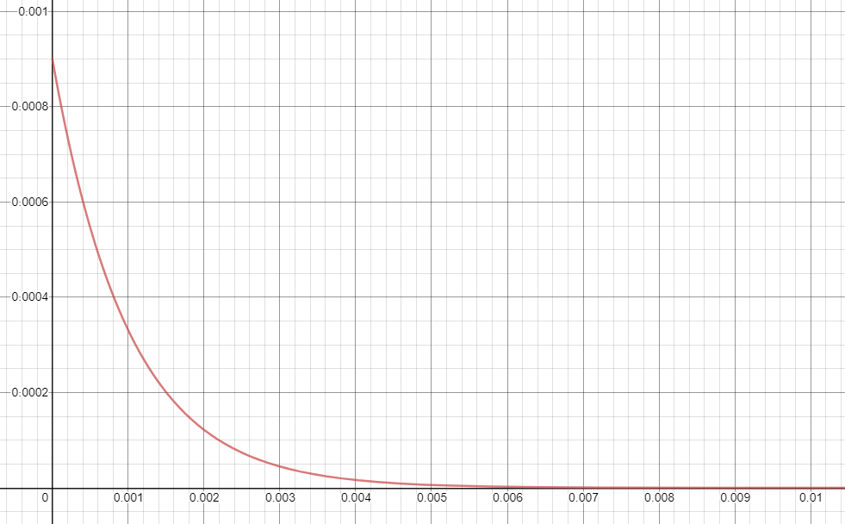
Resistor-Capacitor
Voltage (V on y-axis and sec. on x-axis)
Current (A on y-axis and sec. on x-axis)

Slide 4
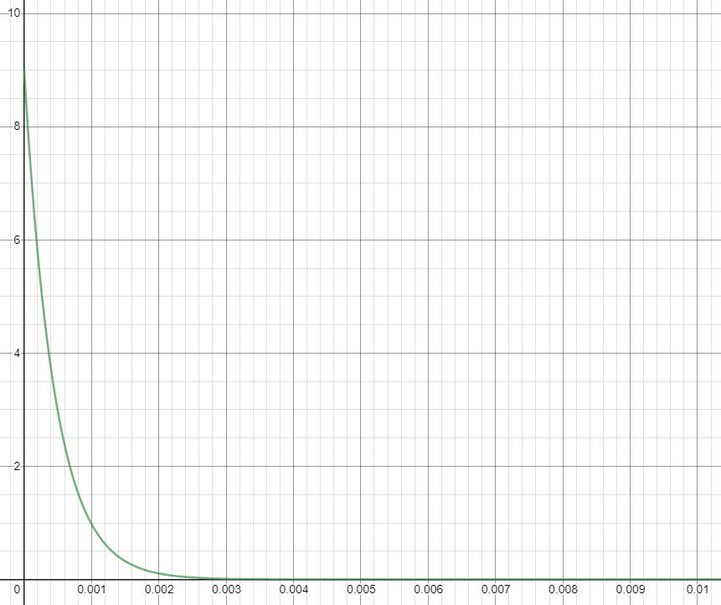
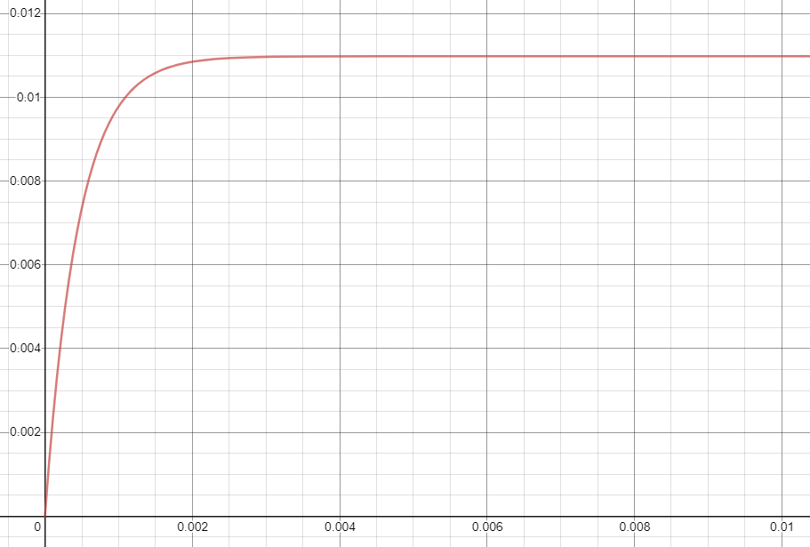
Resistor-Inductor
Voltage (V on y-axis and sec. on x-axis)
Current (A on y-axis and sec. on x-axis)

